Slide 1
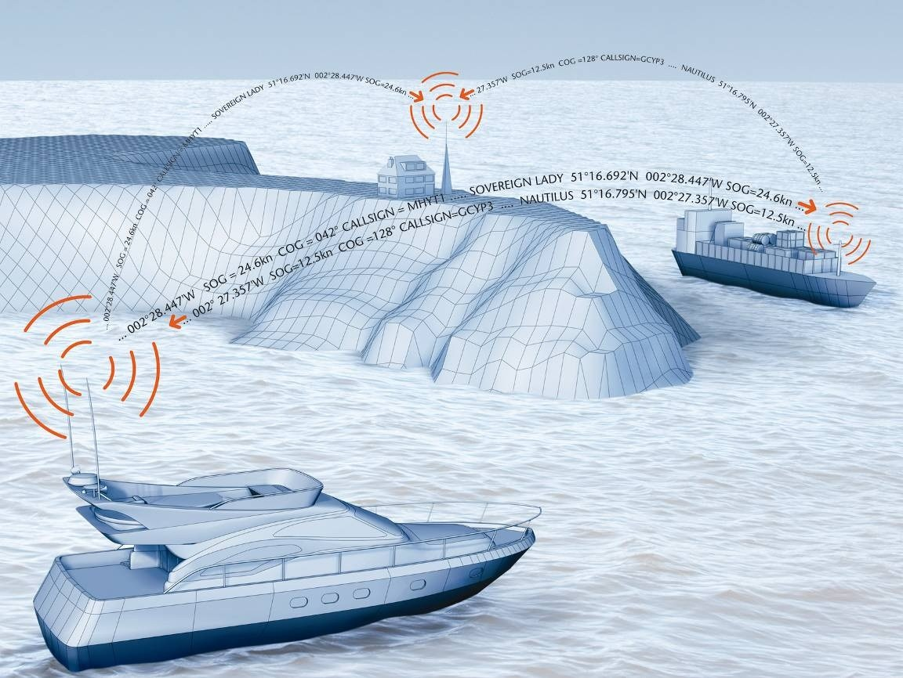
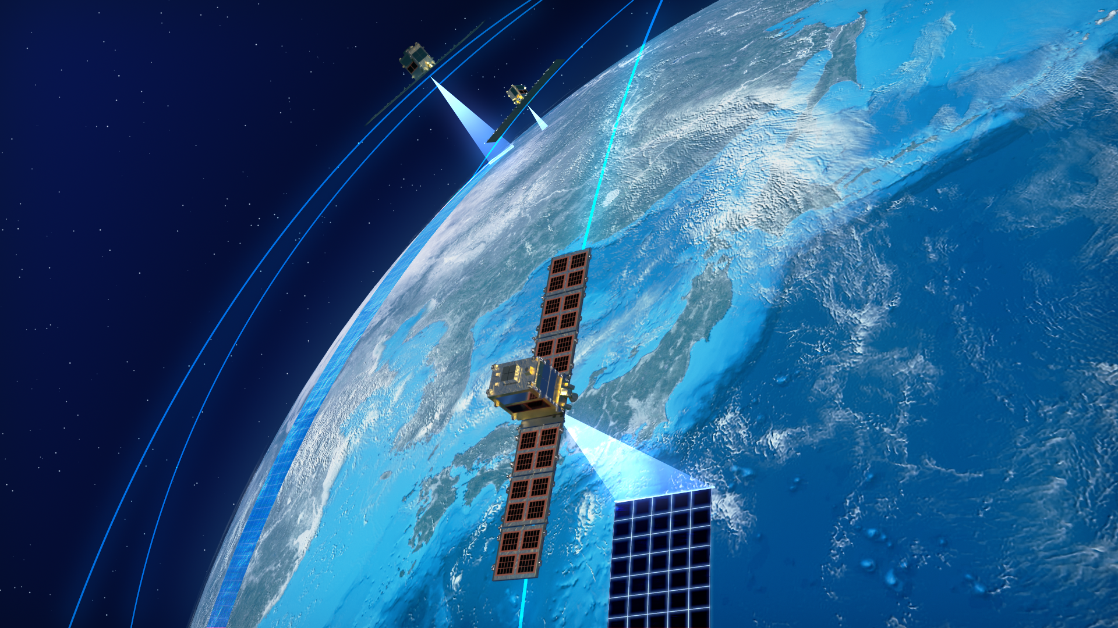
Deep-learning based detection of vessels on a satellite synthetic-aperture radar (SAR) images as a measure to improve safety and efficiency of maritime traffic
D7047E Berezin Ilya, Chippa Meenakshi

Slide 2
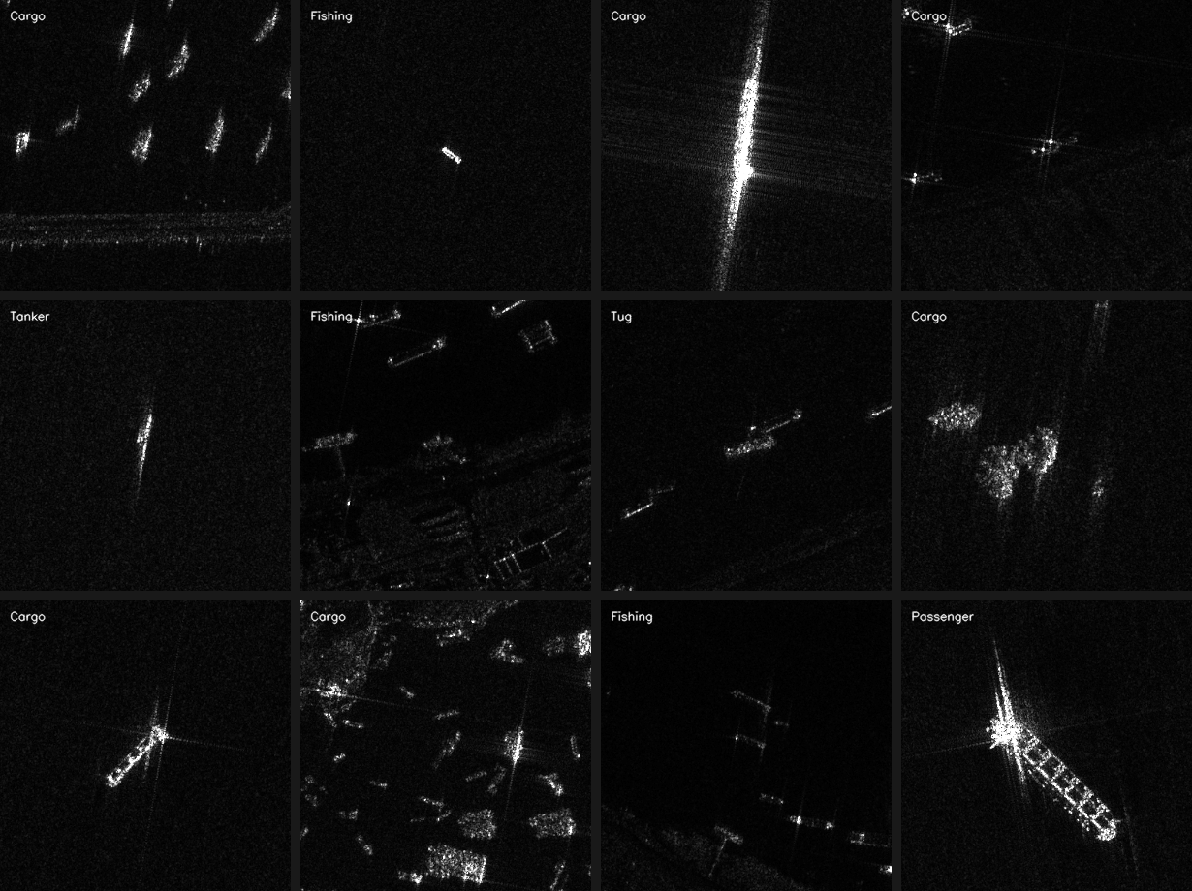
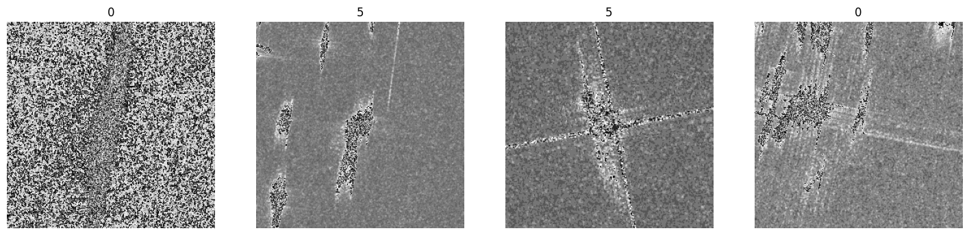
Typical SAR images

Slide 3
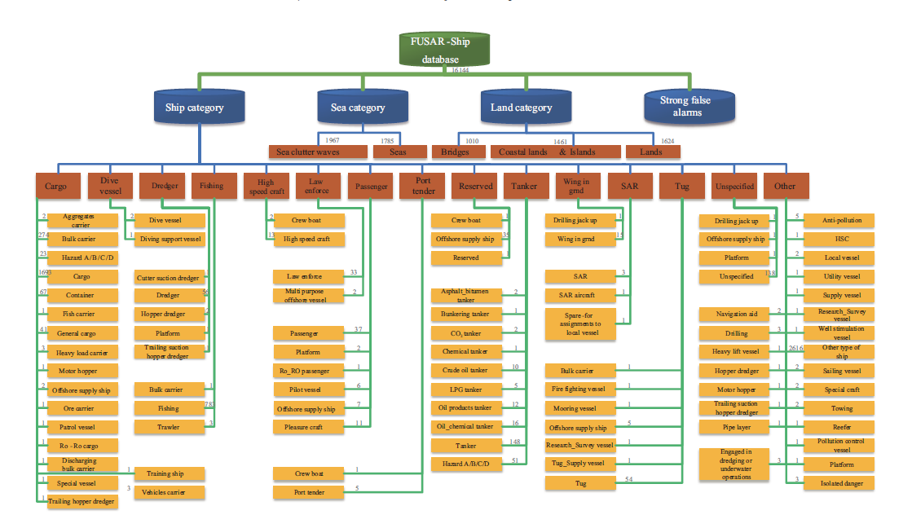
FUSAR dataset

Slide 4
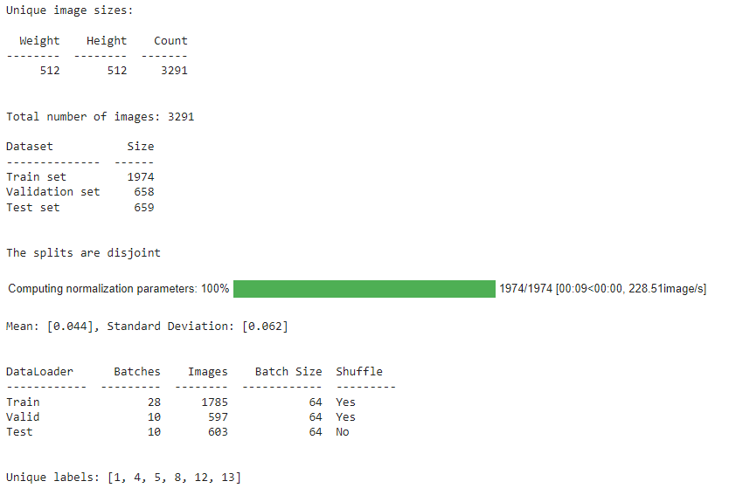
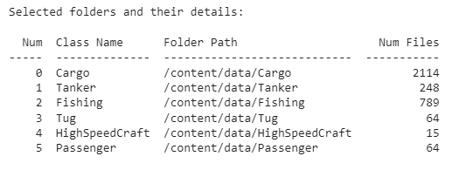
FUSAR dataset imbalance
Dynamical categories

Slide 5
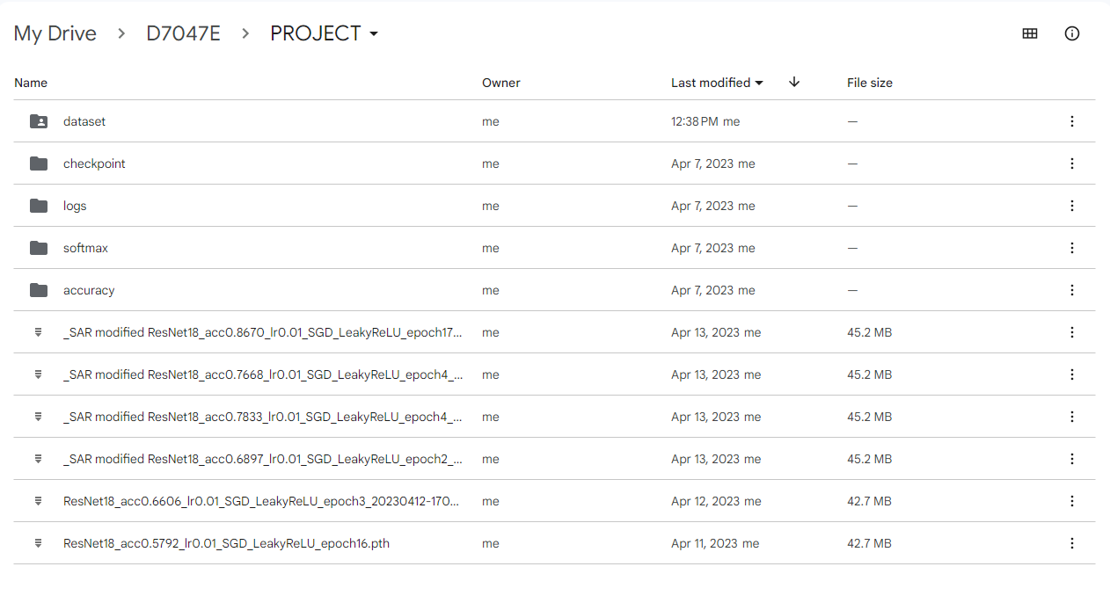
Project structure

Slide 6
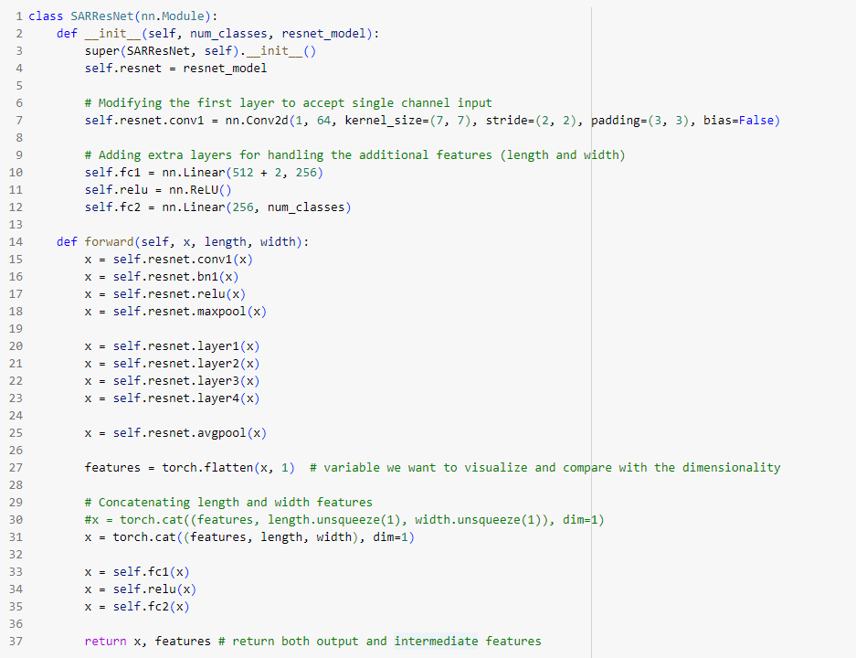
Model and details on AIS provided dimensions
Pretrained ResNet18 model
Layers freeze to avoid random weights backpropagation
Concatenation of extracted image features with AIS length and width
The model is specifically designed to handle SAR images with additional length and width features. This type of hybrid architecture, combining CNN for image data and fully connected layers for structured data, as the task required the model to understand both image and tabular data.

Slide 7
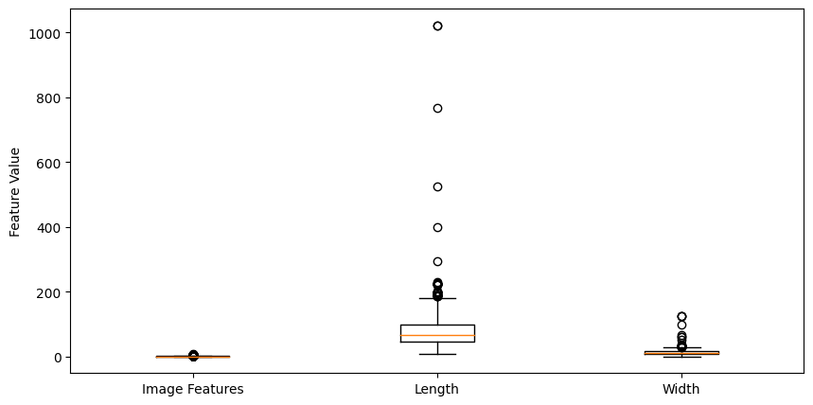
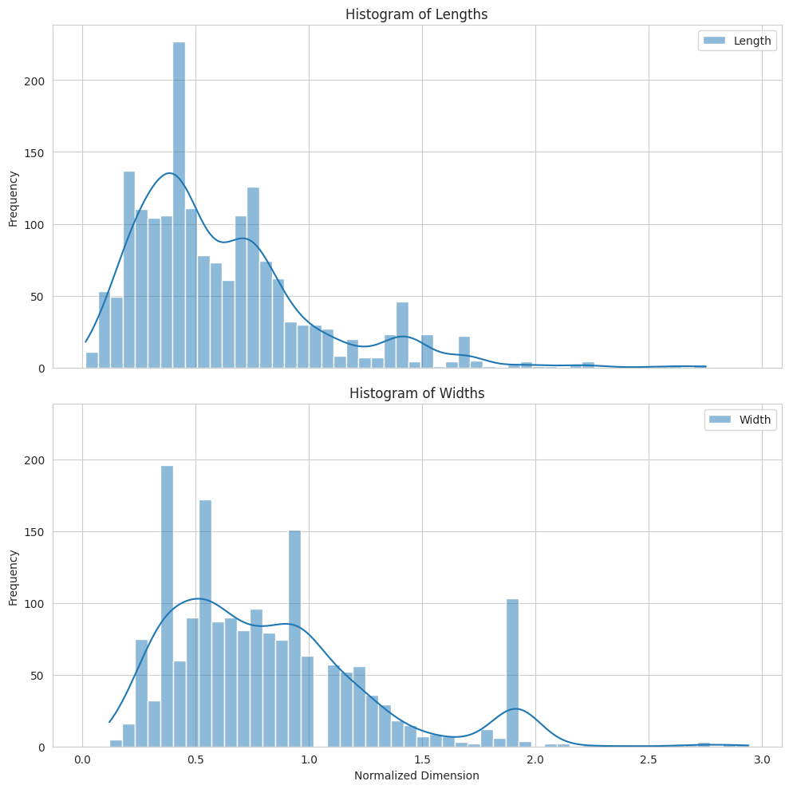
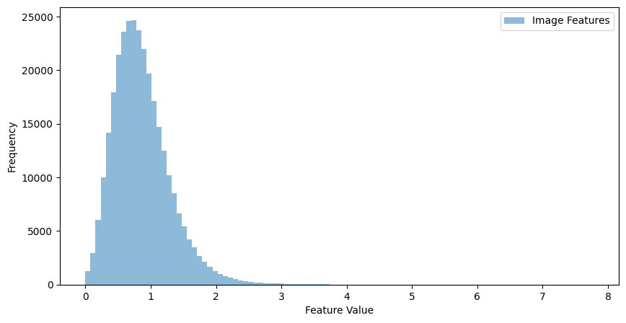
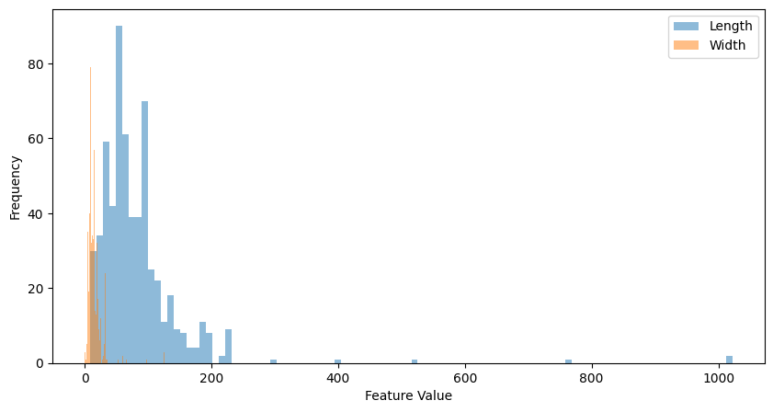
AIS provided dimensions compared with extracted Image Features

Slide 8
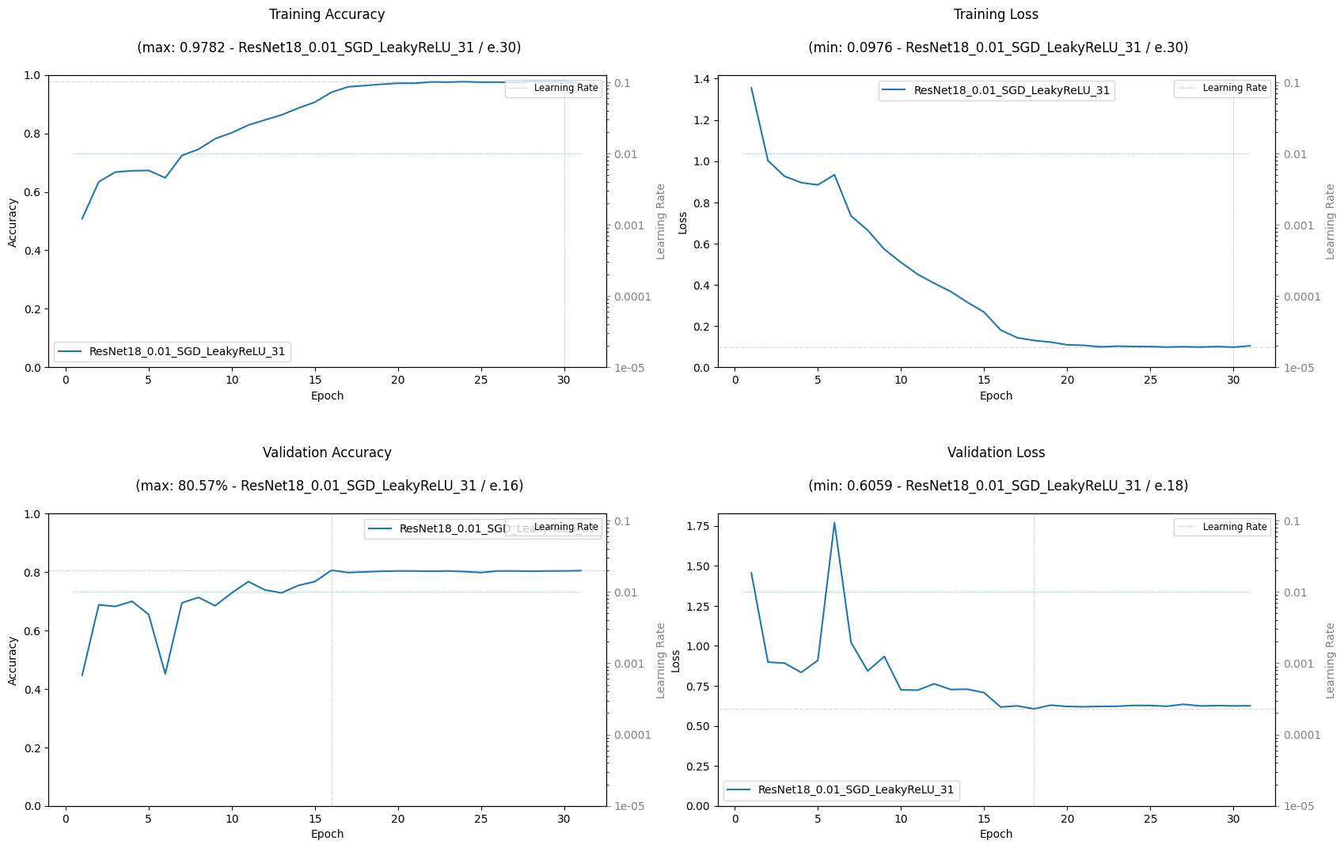
Results with pretrained ResNet18 model

Slide 9
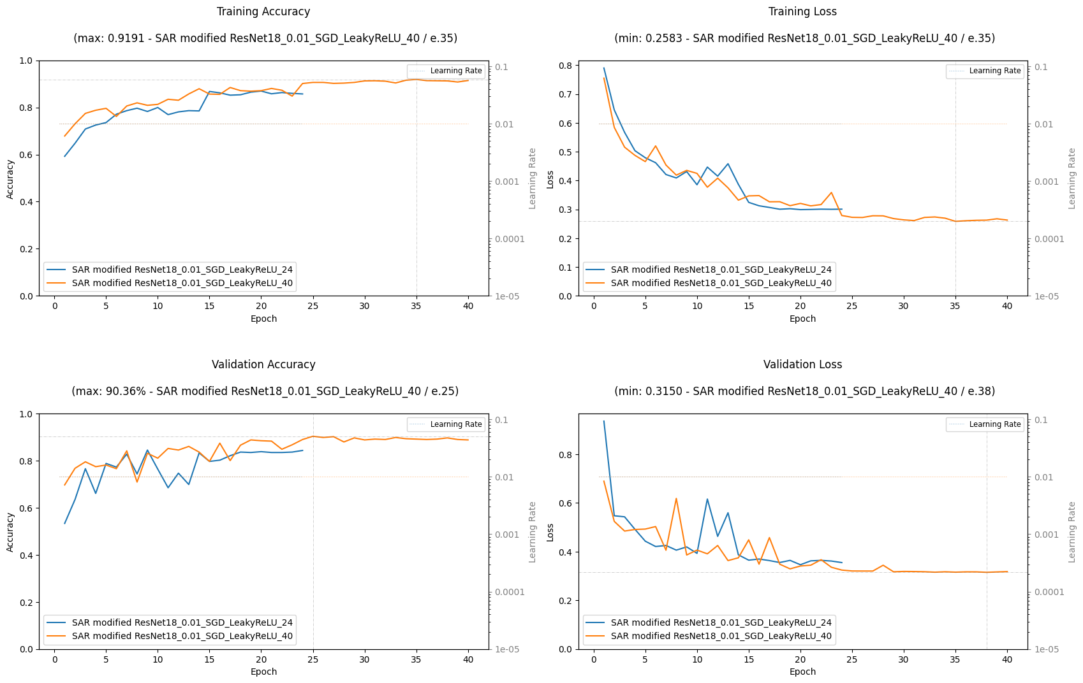
Results with modified ReNet18 model, using nn.CrossEntropyLoss(weight=class_weights_tensor.to(device), reduction='mean')

Slide 10
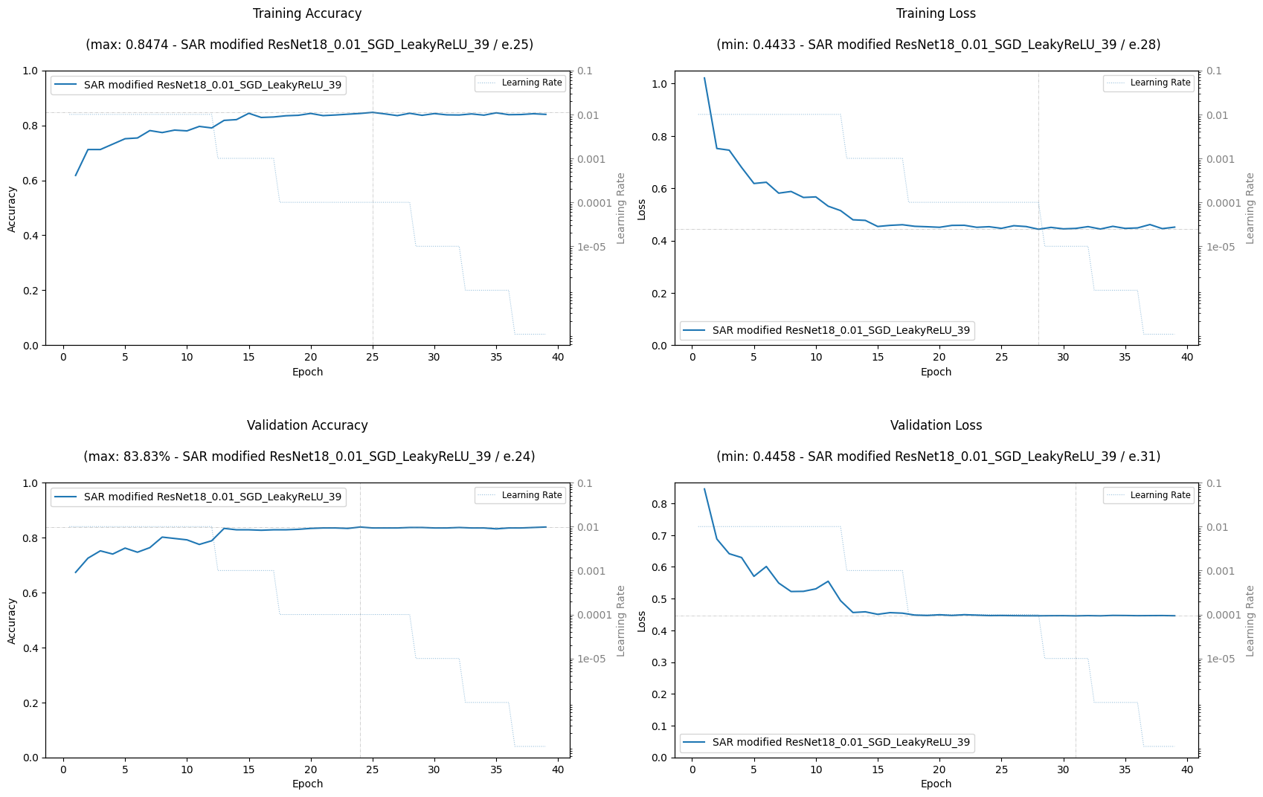
Results with modified ReNet18 model on 6 classes Image features concatenated with AIS labels - length & width

Slide 11
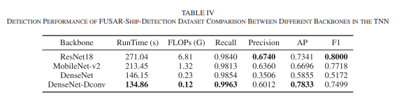
Results for various model modifications
Project
Published research
Model | Model | Test Accuracy
Model1: | Pretrained ResNet18 | 70.57%
Model2: | Modified ReNet18 model on 3 classes | 90.36%
Model3: | Modified ReNet18 model on 6 classes​ | 84.98%

Slide 12
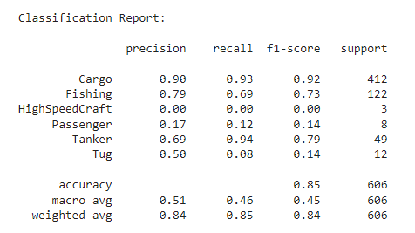
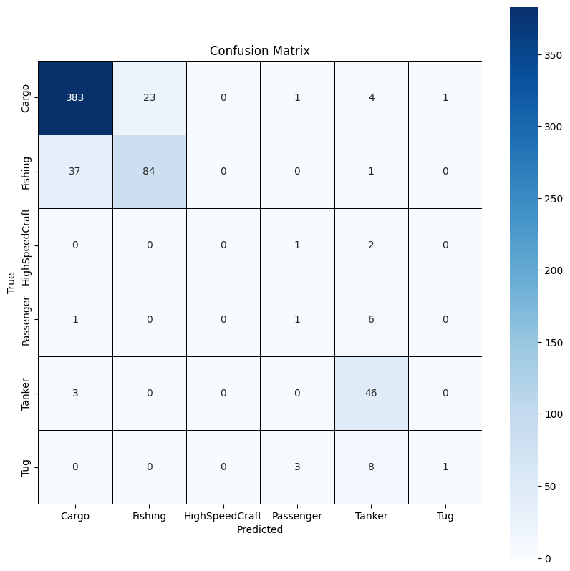
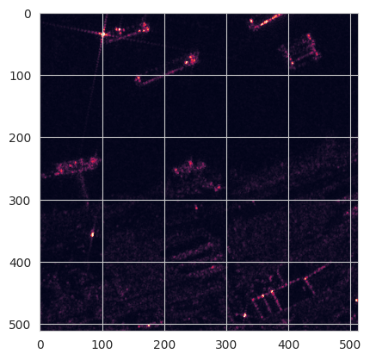
Confusion matrix and Classification report

